Slide 1
Computer Organization · BIT Y4T1
IF
ID
EX
MEM
WB
PIPELINE CPU PROJECT · MIDTERM REVIEW
A 5-stage RISC-V
RV32I processor in Verilog
46 instruction encodings, full forwarding, a load-use interlock, branch prediction and machine-mode interrupts. Verified against a golden reference model we wrote ourselves, and synthesized for an Artix-7.
IF
ID
EX
MEM
WB
Colours used throughout: bypass network interlock / stall flush / killed free
DESIGN
[ 杨辉宗 ] · microarchitecture, hazard scheme, design document
CODING
[ 吴宏庆 ] · 19 RTL modules, assembler, reference model
TESTING
[ 王伟成 ] · testbenches, trace diffing, performance measurement
What we propose to build, why we chose it, and the prototype that already shows it works.

Slide 2
01 · Design
IF
ID
EX
MEM
WB
2 / 20
THE TASK
What we are building, and how it will be judged
THE COURSE TASK, VERBATIM
WHAT WE COMMIT TO DELIVER
"Design a pipeline CPU based on MIPS/RISC-V or other instruction subsets with more than 16 instructions. And implement the CPU by Verilog HDL. Use the simulation tools to show the function and performance of your CPU."
MACHINE
A 5-stage in-order RV32I pipeline, 46 encodings, full forwarding, load-use interlock, flush-based recovery
BONUS x2
A 2-bit branch predictor and machine-mode interrupts, each measurable and each switchable off
TOOLCHAIN
An assembler and an independent reference model, because the named tool cannot execute this ISA
EVIDENCE
A self-checking test suite, a design document, and a synthesis report for xc7a35tcpg236-1
"Bonus items: support interrupt, cache, branch prediction."
HOW WE WILL KNOW IT IS DONE
EXPLICITLY OUT OF SCOPE
CORRECT
Every instruction checked against an independent implementation, byte for byte
No FPGA board bring-up. The task says simulation tools, so we deliver simulation plus a synthesis report on a named part. No instruction cache; the reasoning is on the next slide.
FUNCTION
Shown in simulation, every test stating its own PASS or FAIL verdict
PERFORMANCE
Measured by switching a feature off and re-running. A number with no baseline proves nothing
SYNTHESIS
An fmax and a utilisation figure on a named part, with the critical path identified
We are past proposing this on paper. A working prototype already meets every criterion above, and the rest of this talk is the evidence.

Slide 3
01 · Design
IF
ID
EX
MEM
WB
3 / 20
SPEAKER 1 OF 3 · [ 杨辉宗 ]
Design — the specification the RTL was written against
Every decision below was made and written down before a line of Verilog existed, so the coder implemented a specification rather than inventing one.
OWNED END TO END
46
22
1,708
MICROARCH
Five-stage structure, pipeline-register fields, PC-select priority
encodings specified
control signals
lines of spec
37 core + 9 system
per instruction
the living document
ISA
Instruction subset, all six formats, immediate extraction, CSR zimm
DELIVERED
HAZARDS
Forwarding rules and priority, load-use interlock, flush rules
• The 46-encoding ISA table and all six immediate formats
• The 46-row control truth table, 22 signals wide
• CSR, trap and mret semantics; docs/DESIGN.md kept current
MEMORY
Harvard layout, sizes, byte lanes, misalignment policy, reset
TRAPS
CSR set, mepc / mcause, the ecall versus interrupt asymmetry
WHERE TO LOOK
REVIEW
Read every RTL module against the spec before it was committed
docs/DESIGN.md. The control truth table is generated from the same source that generates the decoder's test vectors, so document and test cannot drift apart.
The design document is not a write-up of what was built. It is what the build was checked against.

Slide 4
01 · Design
IF
ID
EX
MEM
WB
4 / 20
SCOPE
46 encodings against a 16-instruction requirement
COURSE MINIMUM
16
IMPLEMENTED
46
2.9× the requirement
R-TYPE
10
I-ARITHMETIC
9
LOADS
5
STORES
3
add sub sll slt sltu
xor srl sra or and
addi slti sltiu xori ori
andi slli srli srai
lb lh lw lbu lhu
sign / zero extended
sb sh sw
byte-lane writes
BRANCHES
6
U-TYPE & JUMPS
4
SYSTEM — THE INTERRUPT BONUS
9
beq bne blt bge
bltu bgeu
lui auipc
jal jalr
csrrw csrrs csrrc csrrwi csrrsi csrrci
ecall ebreak mret
All 46 follow the RISC-V Unprivileged and Privileged specifications exactly. fence and wfi decode as illegal.
ebreak doubles as the simulation halt. RV32I has no halt instruction, so it raises a done flag the testbench watches.

Slide 5
01 · Design
IF
ID
EX
MEM
WB
5 / 20
DESIGN CHOICES
What we chose, and what we ruled out
Decision
We chose
Instead of
Why
ISA
RISC-V RV32I, 46 encodings
MIPS
A clean orthogonal encoding we could assemble and model ourselves, and 2.9x the 16-instruction minimum
Pipeline
5-stage in-order
Single-cycle, or a deeper pipe
The shallowest design that still exposes all three hazard classes, which is the point of the exercise
Branches
jal in ID, branches and jalr in EX
Everything in one stage
jal needs no register, so resolving it early is free. Branches need a compare, and doing it in EX keeps it off the decode path
Bonus A
2-bit branch history table
Static prediction only
Cheap in area, and its accuracy is a number we can report honestly, including where it loses
Bonus B
CSRs, traps and mret
--
Exercises privileged state and trap semantics, demonstrable from a testbench-driven interrupt line
Bonus C
Instruction cache - CUT
Building it anyway
Behind a single-cycle memory a hit and a miss cost the same, so CPI would not move, and the suite fits in 2 KB so the hit rate reads ~99 %. Designed and written up, not built.
Reference
Our own Python model
Mars4_5, as the brief names
Mars executes MIPS. It cannot assemble or check RISC-V, so there was no oracle to borrow
Target
Simulation + synthesis report
FPGA board demo
The brief asks for simulation. Synthesis still yields fmax and utilisation without board bring-up risk
The cache was cut on a measurement argument, not a schedule one. A figure that reads 99 % on every program says nothing about the design.

Slide 6
01 · Design
IF
ID
EX
MEM
WB
6 / 20
DATAPATH
Five stages, three bypasses, one interlock
branch · jalr · mtvec · mepc — EX, 2 bubbles
jal target — ID, 1 bubble
IF
ID
EX
MEM
WB
pc.v + PC-select mux
control.v · alu_ctrl.v
forward mux A / B / C
dmem.v 4 KB
lane extend + wb mux
imem.v 4 KB sync read
regfile.v read
alu.v 11 operations
byte-lane select
regfile write (x0 dropped)
bht.v lookup
imm_gen.v 6 formats
branch_unit.v · csr.v
commit trace port
IF/ID
ID/EX
EX/MEM
MEM/WB
EX/MEM → EX distance 1 priority
MEM/WB → EX distance 2
carries load data
load-use interlock — hold PC and IF/ID, bubble ID/EX
Every stage boundary is an explicit register with stall and flush inputs, so the hazard logic plugs in without touching the datapath.

Slide 7
01 · Design
IF
ID
EX
MEM
WB
7 / 20
FEASIBILITY
What already works
Every commitment on the objective slide has been met once already, on a prototype that runs today. The schedule on the next slide is what remains.
BUILT AND RUNNING
DESIGN
Microarchitecture, hazards, memory and the 46-row control truth table, documented
BONUS B
Interrupts. Trap entry, ISR and mret, all diff-tested against the reference model
RTL
19 Verilog modules; the machine executes all 46 encodings
VERIFICATION
Every suite green at all four build configurations
BONUS A
Branch predictor, with accuracy and cycle deltas measured
SYNTHESIS
Placed and routed; setup timing met at 74 MHz on the target part
The specification came first and the implementation followed it. That order is why the schedule on the next slide is credible.

Slide 8
01 · Design
IF
ID
EX
MEM
WB
8 / 20
DELIVERABLES
What we hand over, who owns it, and when
DELIVERABLES, ONE OWNER EACH
MILESTONES
Artefact
Owner
State
SEP 11-12
Apply the two timing improvements; full regression after each
Design document and control truth table
Design
complete
SEP 13-14
Final synthesis run; lock the performance chapter
19 RTL modules, plain Verilog-2001
Coding
complete
SEP 15
Feature freeze - bugfix and measurement only
SEP 16
Demo script, waveform captures, rehearsal
Assembler and reference model
Coding
complete
Final presentation and demo
SEP 17
Self-checking test suite
Testing
complete
Performance measurements
Testing
preliminary
RISKS, AND WHAT WE DO ABOUT EACH
Synthesis report: fmax and utilisation
Testing
one run left
TIMING
If the two improvements do not close cleanly by Sep 14, we freeze on the 74 MHz build that is already verified
Live demo and script
All three
Sep 16
REGRESSION
One change moves when a load result is available, so it can shift CPI. Figures are re-measured after the freeze
TOOLCHAIN
If Vivado 2019.2 is required, the RTL is plain Verilog-2001 with no IP and a project script is committed
Every deliverable has exactly one owner, and cross-review is by reading each other's work, not by silent edits.

Slide 9
02 · Implementation
IF
ID
EX
MEM
WB
9 / 20
SPEAKER 2 OF 3 · [ 吴宏庆 ]
Coding — the RTL, and the toolchain it needed
The course names Mars4_5 as the simulator, but Mars executes MIPS. Building a RISC-V machine meant building the tools to assemble and check it first.
OWNED END TO END
19
861
589
RTL
All 19 modules: pipeline registers, datapath, hazard logic, CSR file, BHT, counters, memories, top level
RTL modules
lines of assembler
lines of ISS
Verilog-2001
asm.py
iss.py
ASSEMBLER
Two-pass, six formats, directives and pseudo-ops, emits a $readmemh image
DELIVERED
• 19 synthesizable modules, no vendor IP, no block design
• asm.py and iss.py, cross-validated against each other
• sim/run.sh and vivado/synth.sh, reproducible from the shell
REFERENCE
A second implementation of the ISA in Python, emitting the commit trace
FLOWS
The xsim batch flow and the non-project synthesis flow, both scripted
WHERE TO LOOK
FIXES
Every failure the tester raised, re-verified by their regression
rtl/ and tools/. The machine executes all 46 encodings and places and routes at 74 MHz on the target part.
The assembler and the reference model were cross-validated against each other before any RTL existed, so the oracle was trustworthy on day one.

Slide 10
02 · Implementation
IF
ID
EX
MEM
WB
10 / 20
DATA HAZARDS
Forwarding: two distances, one priority rule
DISTANCE 1 — PRODUCER IS IN MEM
DISTANCE 2 — PRODUCER IS IN WB
c1
c2
c3
c4
c5
c6
c1
c2
c3
c4
c5
c6
addi x5, x0, 100
IF
ID
EX
MEM
WB
addi x5, x0, 100
IF
ID
EX
MEM
WB
fwd = 2'b10
IF
ID
EX
MEM
WB
IF
ID
EX
MEM
WB
add x6, x5, x5
nop
fwd = 2'b01
add x6, x5, x5
IF
ID
EX
MEM
PRIORITY — WHEN BOTH MATCH, EX/MEM WINS
The instruction in MEM is the newer writer, so its value is the one the architecture says you read. Testing MEM/WB first resurrects the stale value.
x5 = 100 then x5 = x5 + 1 then read x5 must see 101, while 100 is still sitting in MEM/WB
A producer whose destination is x0 wrote nothing, so it is never forwarded. Otherwise x0 would read non-zero for exactly one instruction.

Slide 11
02 · Implementation
IF
ID
EX
MEM
WB
11 / 20
THE TWO HAZARDS FORWARDING CANNOT FIX
One cycle for a load-use, two for a taken branch
LOAD-USE INTERLOCK — 1 STALL CYCLE
TAKEN BRANCH — 2 BUBBLES
c1
c2
c3
c4
c5
c6
c7
c1
c2
c3
c4
c5
c6
resolved here
lw x7, 0(x5)
IF
ID
EX
MEM
WB
beq (taken)
IF
ID
EX
MEM
WB
add x8, x7, x0
IF
ID
ID
EX
MEM
WB
branch + 4
IF
ID
X
sub x9, x8, x1
IF
ID
ID
EX
MEM
branch + 8
IF
X
violet = held. PC and IF/ID freeze, ID/EX takes a bubble.
One cycle is always enough. By then the load is in WB.
target
IF
ID
EX
COST load-use 1 stall jal 1 bubble taken branch 2 jalr 2 ecall / interrupt / mret 2 wrong-path slots never write and never retire
A redirect always overrides a stall: the instruction that raised the stall is being killed anyway, so waiting for it would deadlock the redirect.

Slide 12
02 · Implementation
IF
ID
EX
MEM
WB
12 / 20
BONUS A — BRANCH PREDICTION
64 two-bit counters, and an honest cost table
reset state
64 entries
index pc[7:2]
untagged
prediction = state[1]
00
taken
01
taken
10
taken
11
strongly not taken
not taken
weakly not taken
not taken
weakly taken
not taken
strongly taken
predict NOT TAKEN
predict TAKEN
WHAT IT COSTS, BY OUTCOME
WHERE EACH STEP HAPPENS
Prediction
Outcome
Bubbles
Why
LOOKUP — IF
indexed by the fetch PC, in parallel with the fetch
not taken
not taken
0
the fall-through was already being fetched
taken
taken
1
the ID redirect kills one instruction
CARRY — IF/ID
the counter state travels with the instruction
not taken
taken
2
EX redirect kills ID and IF
ACT — ID
redirect to PC + immB, the 1-bubble path jal uses
taken
not taken
2
wrong target fetched, then re-fetch
RESOLVE — EX
compare with the real outcome; flush 2 on a mispredict
UPDATE — EX
saturating increment or decrement
There is no target buffer. The target is PC + immB, which ID already computes. That saves a tagged CAM and costs one bubble on a correct taken prediction.

Slide 13
02 · Implementation
IF
ID
EX
MEM
WB
13 / 20
BONUS B — INTERRUPTS
The trap point is EX, so mepc is always a real PC
c1
c2
c3
c4
c5
c6
c7
I(n−2)
EX
MEM
WB
retires normally
I(n−1)
ID
EX
MEM
WB
retires normally
I(n)
IF
ID
EX
X
SQUASHED — never retires, never traced
I(n+1)
IF
ID
X
killed
I(n+2)
IF
X
killed
ISR[0]
IF
ID
EX
MEM
handler at mtvec
irq sampled with a valid instruction in EX
mepc ← PC of I(n) · mcause ← 0x8000000B · MPIE ← MIE, MIE ← 0 · PC ← mtvec
ECALL — SYNCHRONOUS
INTERRUPT — ASYNCHRONOUS
LEVEL, NOT PULSE
mcause = 11. mepc points at the ecall, which has not completed. The handler must add 4 before mret.
mcause = 0x8000000B. mepc points at an instruction that never executed. The handler must not add 4. mret re-runs it.
irq is qualified by mstatus.MIE and mie.MEIE. A request raised inside the handler is held, not lost, and taken when mret restores MIE.
That asymmetry, ecall advances mepc and an interrupt must not, is the single most common trap-handling bug.

Slide 14
02 · Implementation
IF
ID
EX
MEM
WB
14 / 20
SYNTHESIS — VIVADO 2026.1, xc7a35tcpg236-1, POST PLACE-AND-ROUTE
Setup timing met at 74 MHz
1,461
819
CONSTRAINT SWEEP — WHERE IT CLOSES
LUTs
flip-flops
Configuration
Period
WNS
Failing
Result
7.0 % of the device
2.0 % of the device
base machine
10.0 ns
−2.483
423
not met
2
44
full design
10.0 ns
−3.235
555
not met
full design
12.5 ns
−0.755
306
not met
block RAMs
LUTs as memory
IMEM + DMEM, 4 % of 50
the 32x32 register file
full design
13.5 ns
+0.052
0
met — 74 MHz
The three points agree to within 1.2 % on 1/(T − WNS). The speed is a property of the design, not of the constraint. Register-to-register hold is met at every point.
CRITICAL PATH — A LOAD FEEDING A BRANCH
DMEM block RAM
clock to output
byte-lane select
+ sign extension
MEM/WB to EX
forwarding mux
branch comparator
branch_unit.v
redirect / flush
reduction
PC register
clock enable
2.454 ns
in WB · 2 x LUT6
load into a branch
3 x CARRY4
endpoint
12.982 ns total 15 logic levels 65 % routing Fixes designed: register the lane extension into WB · precompute the forwarding match bits in ID
74 MHz is measured, not estimated, and the path that limits it is identified. That makes the two planned fixes a scheduled task rather than a hope.

Slide 15
03 · Verification
IF
ID
EX
MEM
WB
15 / 20
SPEAKER 3 OF 3 · [ 王伟成 ]
Testing — proving it, and measuring it
Nothing here is judged by looking at a waveform. Every test states its own verdict, and every golden value comes from the reference model rather than from a person.
OWNED END TO END
26,425
68
0
PLAN
The three-tier strategy and the pass criteria for each tier
unit vectors
programs
trace diffs
11 testbenches
run at 4 configs
against the ISS
UNIT
A testbench for every module that is not pure wiring
DELIVERED
PROGRAMS
One program per encoding, plus nine directed hazard programs
• 11 unit testbenches totalling 26,425 vectors
• 68 assembly programs and the trace-diff harness
• Mutation checks: every testbench shown to FAIL against a broken module
DIFFING
The RTL-versus-reference trace harness and the regression driver
MEASUREMENT
CPI with forwarding on and off, predictor accuracy, synthesis reporting
WHERE TO LOOK
DEMO
The demo script and the evidence captures for the final presentation
Green at all four FORWARDING × BHT_ENABLE configurations, byte-exact against the reference model.
A test that has never been shown to fail is not yet evidence. That is why the mutation checks exist.

Slide 16
03 · Verification
IF
ID
EX
MEM
WB
16 / 20
STRATEGY
Three tiers, and nothing checked by eye
TIER 3 — DIFFERENTIAL TESTING
A second, independent implementation of the same instruction set, written in Python without reference to the Verilog.
iss.py
Both execute the same image and emit the same commit-trace format. The files are diffed line by line, so a mismatch names the exact retiring instruction.
TIER 2 — SELF-CHECKING TESTS
A standalone testbench for every module that is not pure wiring, plus one assembly program per encoding with golden state.
11 + 46
Every vector is generated by the already cross-validated tools, never by a second hand-written copy of the logic being tested.
TIER 1 — THE BATCH FLOW
Every simulation runs through the same three commands in batch mode: no GUI, no waveform viewer, no human judgement in the loop.
xvlog / xelab / xsim
A run exits zero only if the log contains a PASS line and no FAIL line, so a regression cannot pass by being ignored.
The commit trace is <pc> <insn> x<rd>=<value> mem[<addr>]=<value> — the same line from the RTL write-back stage and from the reference model.
A trace diff localises a bug to one retiring instruction. For a five-stage pipeline that is an afternoon of debugging instead of a week.

Slide 17
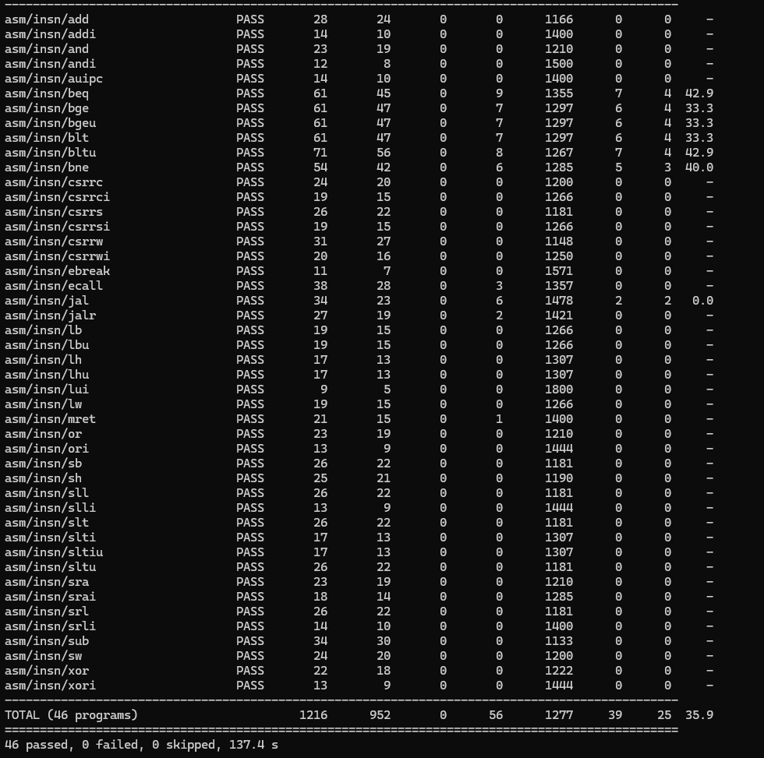
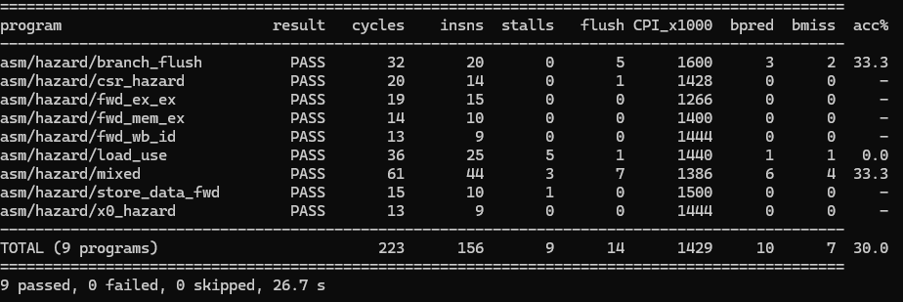
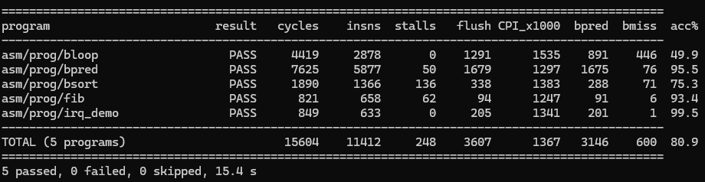
03 · Verification
IF
ID
EX
MEM
WB
17 / 20
RESULTS
Green at every build configuration
26,425
4,323
unit-level vectors
toolchain checks
across 11 testbenches
assembler vs reference
68
4
assembly programs
build configurations
46 + 9 + 5 + 7 + 1
forwarding x predictor
THE FIVE LARGEST SUITES
Suite
Count
What it proves
tb_branch_unit
16,072
all six conditions, signed and unsigned
tb_alu
5,072
11 operations, every shift amount
tb_bht
2,600
saturation, aliasing, same-cycle access
tb_imm_gen
1,865
all six immediate formats and their traps
tb_control
667
the full truth table, 120 illegal encodings
This suite is the acceptance criterion from slide 2, already running. Golden values come from the reference model, never from a person, so a test cannot agree with the RTL by accident.

Slide 18
03 · Verification
IF
ID
EX
MEM
WB
18 / 20
PERFORMANCE
The same three programs finish in 6,799 cycles instead of 9,003
CYCLES PER INSTRUCTION — FORWARDING ON vs OFF
CHANGE IN CYCLE COUNT WITH THE PREDICTOR ON
2.4
-10
-5
0 %
+5
+10
2.263
-14.5 %
bpred
1.904
95.5 % accurate
1.8
1.707
-8.8 %
fib
1.396
93.4 % accurate
1.368
1.376
+0.5 %
bsort
1.2
ideal CPI = 1.0
75.3 % accurate
bloop
+10.0 %
0.6
49.9 % — adversarial
cycles saved
cycles cost
0
fib
bsort
bloop
READING BOTH CHARTS
1.65x faster
1.38x
1.22x
Forwarding helps most where dependencies are tight. fib gains 1.65x; bloop's load-use stall count is zero even with forwarding on, so there was nothing to save.
The predictor can only win on taken branches. bloop was written to defeat a 2-bit counter, and the 400-cycle loss matches the arithmetic exactly.
forwarding on
forwarding off, stall instead
Slide 2 promised performance measured against a baseline rather than quoted in isolation. This is that measurement, for both bonus features.

Slide 19
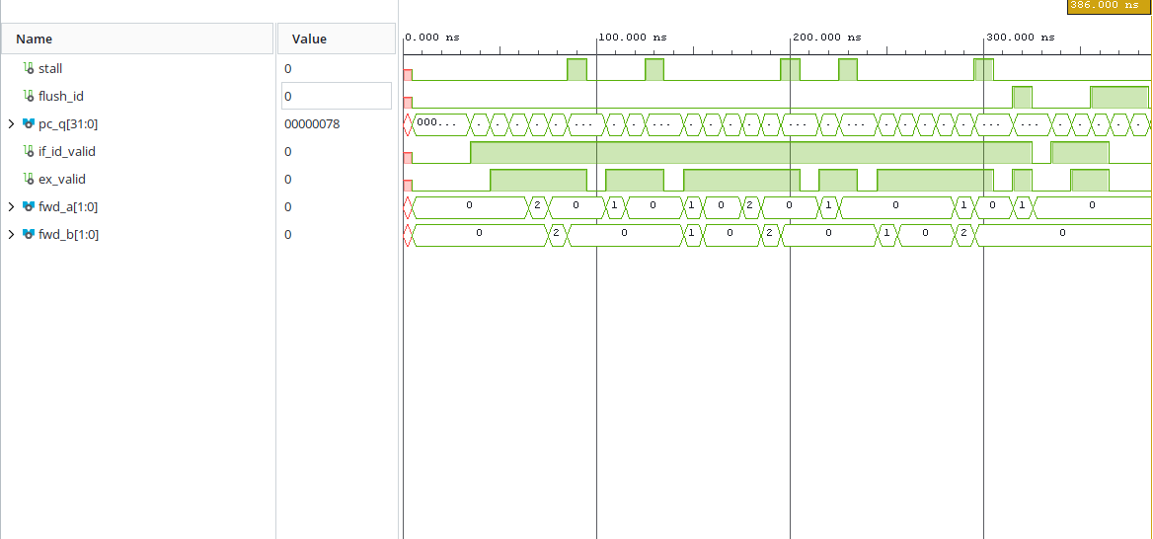
03 · Verification
IF
ID
EX
MEM
WB
19 / 20
SIMULATION EVIDENCE
The hazard logic, seen in the waveform
WHAT THE AUDIENCE SHOULD SEE
STALL HIGH
for exactly one cycle, while pc_q and if_id_pc hold
FWD_A / FWD_B
switching to 01 the cycle after, the MEM/WB bypass delivering the load
FLUSH_IF / ID
pulsing together on the taken branch, two slots killed
TRACE_VALID
never asserting for a killed instruction
WHY THIS SLIDE EXISTS
The course task asks us to use the simulation tools to show the function of the CPU. The PASS lines prove it to a machine. This is the picture that proves it to a person.
Correctness is decided by the self-checking testbenches, never by reading a waveform. The waveform is evidence for the audience, not the test.

Slide 20
Summary
IF
ID
EX
MEM
WB
20 / 20
WHERE WE ARE
What we are committing to, and why we can
FUNCTION
PERFORMANCE
BETWEEN HERE AND SEP 17
46 encodings execute correctly on a 5-stage pipeline with full forwarding, a load-use interlock and flush-based control recovery.
Forwarding is worth 1.32x overall and 1.65x on the tightest dependent loop. The predictor reaches 95.5 % where branches are taken.
Two timing improvements, the final regression on the frozen RTL, the final synthesis run, and the demo package.
Checked against an independent reference model, byte for byte, at every build configuration.
Both measured by counters in the RTL, both with the feature switched off as the baseline.
None of it is new design work. It is finishing measurement on a machine that already runs.
IF
ID
EX
MEM
WB
Every criterion on slide 2 is already met once. What remains is measurement on a machine that runs, not design.

Slide 21
Appendix — if asked
IF
ID
EX
MEM
WB
A1
APPENDIX
Design decisions, and what each one cost
ARCHITECTURE
HAZARDS AND CONTROL FLOW
ISA
RV32I user subset plus simplified machine-mode CSRs
DATA
Full EX/MEM and MEM/WB forwarding; EX/MEM has priority; x0 never forwarded
PIPELINE
5 stages, in-order issue, in-order completion
LOAD-USE
1-cycle interlock, then served by the MEM/WB bypass
MEMORY
Harvard, 4 KB + 4 KB, single-cycle synchronous
JAL / BRANCH
ID, 1 bubble / EX, 2 bubbles
RESET
Synchronous, active high, PC to 0x00000000
BASELINE
FORWARDING disables the bypass network for the CPI comparison
BONUS SCOPE
TOOLCHAIN AND TARGET
BRANCH PRED.
Implemented, 64-entry 2-bit BHT with accuracy counters
HDL
Plain synthesizable Verilog-2001, no IP catalog, no block design
Implemented, mstatus / mie / mtvec / mepc / mcause, CSR instructions, mret, external irq
SIMULATOR
Vivado 2026.1 xsim, batch flow
INTERRUPTS
REFERENCE
Written in Python. Mars4_5 is MIPS-only and cannot execute RISC-V
I-CACHE
Cut on purpose. Behind a single-cycle memory a hit and a miss cost the same, and the suite fits in 2 KB, so the hit rate would read ~99 % and prove nothing
PART
xc7a35tcpg236-1, simulation plus synthesis report, no board
Cutting the cache was a measurement decision, not a schedule one.

Slide 22
Appendix — if asked
IF
ID
EX
MEM
WB
A2
APPENDIX
19 RTL modules, and the two tools we wrote first
rtl/ — 19 MODULES, PLAIN VERILOG-2001
tools/ — THE TOOLCHAIN PROBLEM
PIPELINE REGISTERS — 4
The course names Mars4_5 as the simulator. Mars executes MIPS, not RISC-V, so there was no reference model to check the RTL against. We wrote one.
if_id.v
id_ex.v
ex_mem.v
mem_wb.v
DATAPATH — 7
program.s
iss.py
pc.v
regfile.v
alu.v
alu_ctrl.v
imm_gen.v
control.v
branch_unit.v
asm.py
diff
HAZARD LOGIC — 2
program.hex
cpu_top · xsim
forward_unit.v
hazard_unit.v
BONUS AND INSTRUMENTATION — 3
861
589
bht.v
csr.v
perf_counters.v
lines of assembler
lines of ISS
two-pass, 6 formats
emits the commit trace
MEMORY AND TOP — 3
imem.v
dmem.v
cpu_top.v
Building our own reference model forced every ISA question to be answered once, explicitly, before the RTL was written.

Slide 23
Appendix — if asked
IF
ID
EX
MEM
WB
A3
APPENDIX
How we know the tests would actually fail
MUTATION CHECKS — A BROKEN MODULE MUST PRODUCE FAIL
THE LAST ROW IS THE INTERESTING ONE
Bug injected on purpose
Caught by
Training the predictor with the inverted outcome collapses accuracy. fib falls from 93.4 % to 3.3 %, and bloop costs another 438 cycles.
Yet every program still passes its byte-exact trace diff.
That is the right answer. The predictor only changes when instructions are fetched, never what they compute. Correctness rests entirely on the EX-stage resolution and flush, and the trace diff should be blind to a misprediction rate.
SRA as a logical shift
tb_alu, negative-operand vectors
WB to ID bypass removed
tb_regfile
B-format immediate bit flipped
tb_imm_gen
alu_ctrl reads inst[30] for addi
tb_control, the addi / sub trap
Forwarding priority swapped
asm/hazard/fwd_ex_ex.s
x0 guard removed from forwarding
asm/hazard/x0_hazard.s
Load-use interlock disabled
asm/hazard/load_use.s
lb sign extension removed
tb_dmem and asm/insn/lb.s
BHT trained with the inverted outcome
nothing, and that is correct
A testbench is not trusted until it has been shown to fail against a deliberately broken copy of the module it checks.

